Slide 1
Dashboard in a Day
Power BI Train the Trainer
June 2022 version

Slide 2
Agenda
What is DIAD?
Why host a DIAD?
What do customers take away from DIAD?
How To Organize DIAD?
In-Person Modality
Virtual/Online Modality
How to deliver DIAD

Slide 3
What is DIAD?
1 Day hands-on workshop for Business Analysts, covering the breadth of Power BI capabilities
A complete and free workshop available: presenter deck, demo scripts, step-by-step guide, dataset and train the trainer video
Content is updated monthly and localized to 8 languages
Goals
Help Microsoft field, partners and community leads
Drive customer/partner connection and opportunities
Increase Power BI usage and adoption

Slide 4
Why host a DIAD?
Generate leads by showing your skills and expertise to customers you target
Build trust in your ability to meet customer needs
Accelerate customer adoption in your accounts
Create opportunities for paid training offers

Slide 5
What should customers take away from DIAD?
Walking away from event, customers should
Understand the value of Power BI
Have enough experience with the product to be able to use it when they return to their office
Understand how Power BI differentiates from the competition and become Power BI advocates in their organization
Recognize the expertise of the partner, build trust and a strong foundation for a continuing working relationship
Know what the next steps to learn more about Power BI and become part of the community

Slide 6
Content usage guidelines
The dataset must remain unchanged and is under copyrights.
The Nigeria International Sales data includes errors so that the lab teaches the users to shape data.
If partners want to make any changes to the content, then they should not brand the event as DIAD
The person presenting should be very familiar with Power BI and be able to answer any customer questions related to the workshop or Power BI in general

Slide 7
How to Organize a DIAD?
Prepare
Deliver
Follow Up

Slide 8
How to organize DIAD For trainers:
Prepare
Deliver
Follow up
Download the latest DIAD content from https://aka.ms/diad.
The content is split into 2 parts:
Go through the latest DIAD content
Become familiar with latest product updates: What’s New pages, and webinars
Create a backup tenant with username/passwords
Make sure preview features in Power BI desktop are disabled
Watch the Inclusive Presentations - At A Glance
Please reach out to DIADQ@microsoft.com with any questions
Instructor content: | Attendee Content:
which includes presentation decks, demo scripts, and instructor training material. You’ll need your Microsoft account tied to your Microsoft Partner Network ID to access this content. | Includes the Lab Manual and datasets. This is also hosted on MPN but does not require MPN Access

Slide 9
How to organize DIAD For trainers:
Prepare
Deliver
Follow up
At minimum, a computer with 2-cores and 4GB RAM running Windows 8 / Windows Server 2008 R2, or later
Internet connectivity
If you choose to use Internet Explorer, Microsoft Power BI requires version 10 or greater, otherwise use Edge or Chrome browsers

Slide 10
How to organize DIAD For trainers:
Prepare
Deliver
Follow up
Logistics
Communication
Location
Make sure to have good network connectivity
Registration
Create a registration page for attendees
Marketing
Use your own channels, as well as the Power BI community to market the event
Proctors
Ensure you have additional proctors/moderators to support the trainer in answering customer questions (one presenter and one+ moderator depending on total # of attendees)
We recommend 1:15 instructor to attendee ratio
Confirmation of registration:
Send the attendees an email confirming their registration
Include information about prerequisites for attendees
Ask attendees to download the content from http://aka.ms/DIAD, install Power BI Desktop and sign up or sign-in to the service through http://aka.ms/pbidiadtraining prior to the event
Please include specific instructions related to in-person or virtual delivery available in subsequent slides
Reminder
Send a reminder to the attendees couple of days prior to the event
Ask attendees if they were able to install Power BI Desktop. If not, make sure you have a backup plan (loan laptops, VM, etc.)
Use the email templates in the instructor kit as example

Slide 11
How to organize DIAD In Person delivery
Prepare
Deliver
Follow up
Logistics
Communication
Preparation for trainers
Make sure to have a copy of the customer content available on an external drive for attendees to download
Location
Make sure to have good network connectivity
Setup the room in a Classroom style
Print lab manual for participants
Confirmation of registration:
Include information on location and parking
Survey attendees about dietary preferences
Recommendation to bring own dataset

Slide 12
How to organize DIAD Online Delivery
Prepare
Deliver
Follow up
Logistics
Communication
Choose a delivery platform (Microsoft Teams, Goto Training, etc.)
Set-up the environment and create calendar invites
Make sure you have multiple monitors to avoid flipping between presentation and chat
Make sure you have a Webcam
Registration
Add this disclaimer to the registration page: By joining this meeting, I consent that my name and email might be visible to all other attendees
Location
Make sure to have good network connectivity
Confirmation of registration:
Add this disclaimer in your communications and calendar invite: By joining this meeting, you consent to your name and email being visible to all other attendees. If you do not consent, please do not join the meeting.
Recommend they print out their lab manuals and/or have a second monitor to make following the hands-on-labs easier
Recommend your participants use a headset
Provide Instructions on how to sign-up and download the delivery platform and join the meeting
If required, follow up with attendees to ensure they have installed the delivery platform app

Slide 13
How to organize DIAD Online Delivery
Prepare
Deliver
Follow up
Curtain Warmer
We recommend preparing a ‘curtain warmer’ presentation or video to include important details:
Show the timer to let students know exactly when the training begins
Show the telephone dial-in number, if one is available, some attendees may require dialing-in
Play music to make sure they can hear sound and their speakers are working
Offer chat instructions so they can communicate if they lose connectivity or have problems
Share information about your organization and the presenters/proctors
Share any offers information you would like to present
Share the agenda for the day
During the lab time, keep displaying the 1st page of the lab on the screen and occasionally remind attendees about their expected progress or questions

Slide 14
How to organize DIAD
Prepare
Deliver
Follow up
Ensure participants were able to install the software and sign-up to Power BI. If not, execute your backup plan (loan laptops, VM, demo tenant, etc.)
Ensure attendees sign-up or sign-in to Power BI via http://aka.ms/pbidiadtraining
Do not deliver the labs as an instructor led training
Ask attendees for feedback and satisfaction rating before leaving the session

Slide 15
How to organize DIAD in person delivery
Prepare
Deliver
Follow up
Arrive at least 30 - 60 minutes before the start of the session for set up, catering, etc.
Use time during lunch and breaks to show your own solutions, the user community, Data Stories gallery etc. Make this relevant to the participants based on their industry

Slide 16
How to organize DIAD Online delivery
Prepare
Deliver
Follow up
Join 15 mins early and start the Curtain Warmer Video if you prepared one
Reinforce disclaimer regarding visibility of their name/email to all attendees
Set expectations at the beginning of the sessions
Establish ground rules at the beginning
Let participants know it will be an interactive class
Give specific instructions on how customers can engage
Ask attendees to use Mute when not speaking to avoid any unexpected background noise

Slide 17
How to organize DIAD Online delivery
Prepare
Deliver
Follow up
Camera Usage:
If comfortable, turn on your camera. Note, camera use is a personal decision
Use camera for introductions at the beginning of the event
Turn off camera when delivering training content
Turn camera back on for Q&A and discussions with attendees
There may be benefits of using camera with individuals who are hearing impaired, visually impaired may prefer voice only conversation

Slide 18
How to organize DIAD Online delivery
Prepare
Deliver
Follow up
Driving participation
Participation / Temp Checks – This is one of the hardest things to accomplish in a virtual training but here are some tips:
Ask lots of questions and encourage dialogue using the Chat feature and schedule Q&A breaks for open discussion
Poll and/or survey/quiz the attendees in real-time
Say participant names frequently to acknowledge their contributions in the chat “John, you made a great point – thank you!” When participants hear their own names during a session, they pay closer attention.

Slide 19
Agenda (times are approximate and will be fluid with the class)
Morning
09:00 AM – 10:00 AM | Introduction to Power BI and Power BI Demo
10:00 AM – 10:30 AM | Lab 1 Accessing & Preparing the data
10:30 AM – 10:45 AM | Break
10:45 AM – 11:15 AM | Lab 1 Solution + Questions
11:15 AM – 11:45 AM | Lab 2 Data Modeling and Exploration + (Power BI desktop optional demo )
11:45 AM – 12:15 PM | Lab 2 Solution + Questions
12:15 PM – 01:00 PM | Break for lunch
Afternoon
01:00 PM – 01:30 PM | Lab 3 Visualizations
01:30 PM – 02:00 PM | Lab 3 Solution + Questions
02:00 PM – 02:30 PM | Lab 4 Publishing and accessing Reports + (Power BI service optional demo )
02:30 PM – 02:45 PM | Break
02:45 PM – 03:15 PM | Lab 4 Solution + Questions
03:15 PM – 03:45 PM | Lab 5 Building a Dashboard and Sharing
03:45 PM – 04:15 PM | Lab 5 Solution + Questions
04:15 PM – 05:00 PM | Q&A

Slide 20
How to organize DIAD Follow up with attendees after the event
Prepare
Deliver
Follow up
Day of the event:
“Thank you” email, including additional resources
1-2 weeks after the event:
Provide an update on what’s new in Power BI
Check with the attendees if they had a chance to work on their own data?
Ask the attendees if they would they be interested in one of your solutions?
Provide feedback about your experience - on the workshop content or the product - to DIADQ@microsoft.com

Slide 21
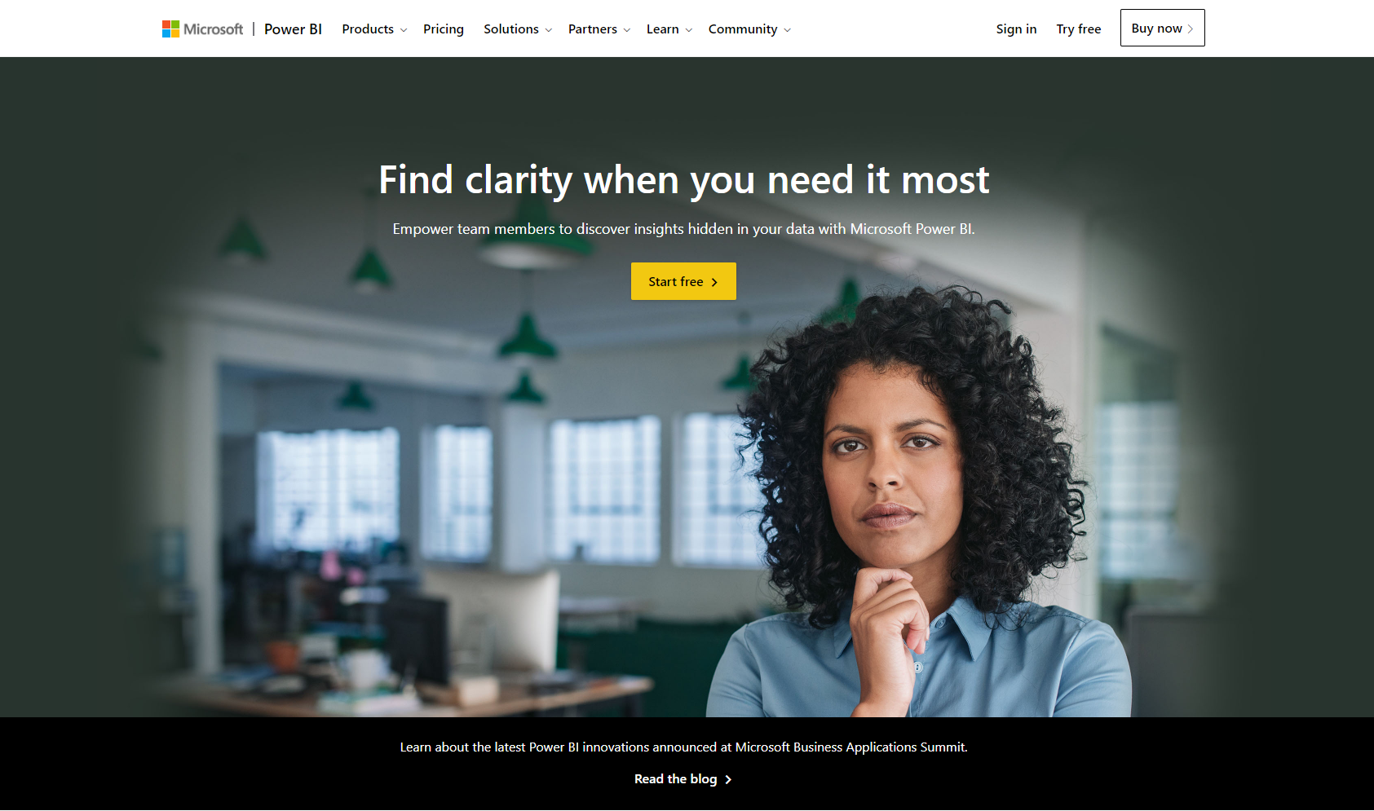
Get Started Now at PowerBI.com

